Slide 1
SRI VENKATESWARA COLLEGE OF ENGINEERING STACK USING QUEUE SHAIK MOHAMMED MUDASSIR 22BFA04265

Slide 2
ABSTRACT
In this approach, we can use a single queue to simulate the stack. When an element is pushed onto the stack, we add it to the queue, but we need to rearrange the queue to make sure the most recently added element stays at the front.

Slide 3
OUTPUT
Popped element: 30
Popped element: 20
Popped element: 10

Slide 4
ALGORITHM
Take a single queue.
push(x): Push the element in the queue.
Use a for loop of size()-1, remove element from queue and again push back to the queue, hence the most recent element becomes the most former element and vice versa.
pop(): remove the element from the queue.
top(): show the element at the top of the queue.
size(): size of the current queue.
Repeat step3 at every insertion of the element.

Slide 5
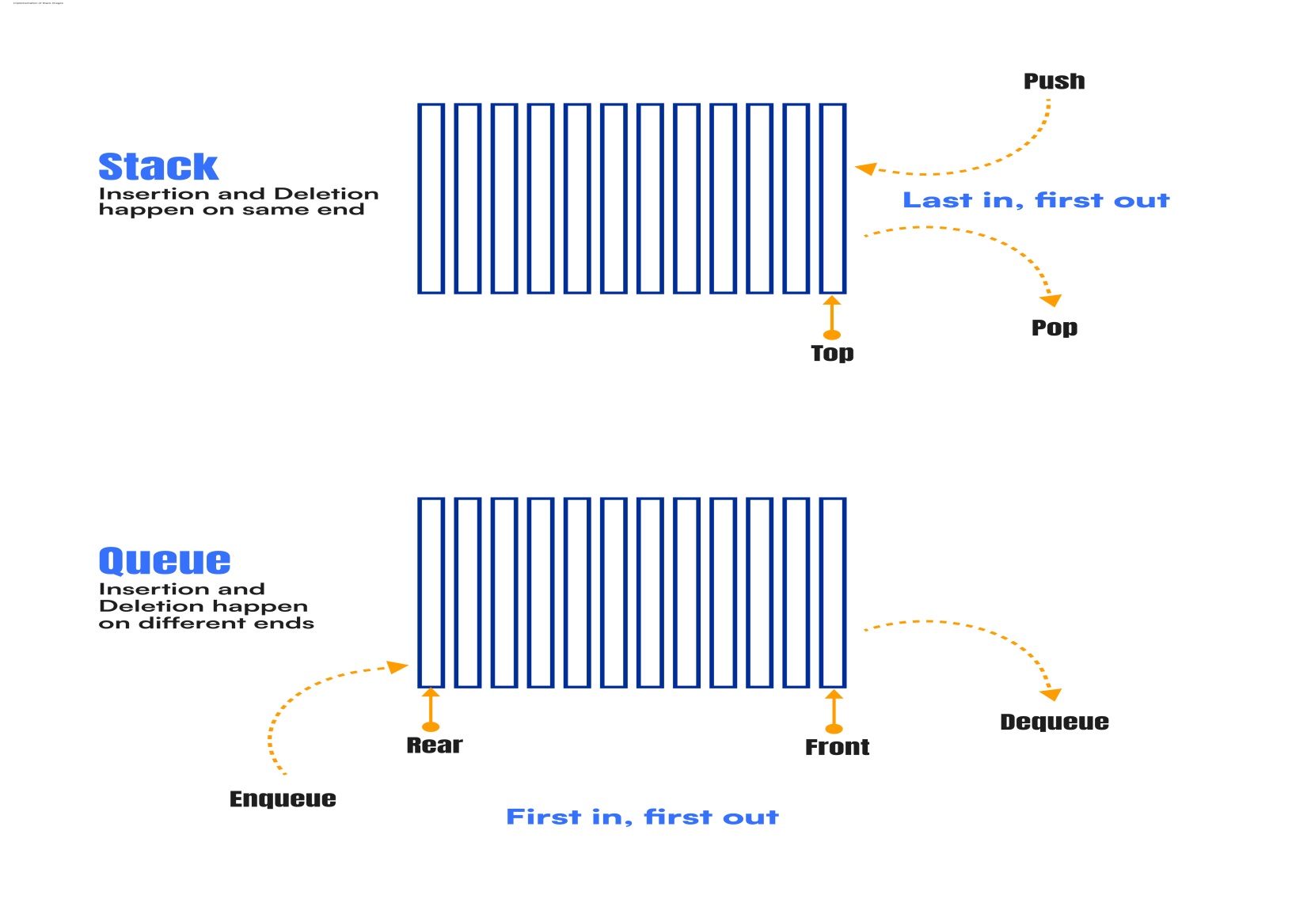

Slide 6
C-CODE FOR PROBLEM
#include <stdio.h>
#include <stdlib.h>
#define MAX_SIZE 100
typedef struct Queue {
int arr[MAX_SIZE];
int front, rear;
} Queue;
void initQueue(Queue* q) {
q->front = 0;
q->rear = -1;
}
int isEmpty(Queue* q) {
return q->front > q->rear;
}
int isFull(Queue* q) {
return q->rear == MAX_SIZE - 1;
}
void enqueue(Queue* q, int value) {
if (isFull(q)) {
printf("Queue is full!\n");
return;
}
q->arr[++(q->rear)] = value;
}
int dequeue(Queue* q) {
if (isEmpty(q)) {
printf("Queue is empty!\n");
return -1;

Slide 7
}
return q->arr[(q->front)++];
}
void push(Queue* q, int value) {
enqueue(q, value);
int n = q->rear - q->front;
while (n--) {
enqueue(q, dequeue(q));
}
}
int pop(Queue* q) {
if (isEmpty(q)) {
printf("Stack is empty!\n");
return -1;
}
return dequeue(q);
}
int main() {
Queue q;
initQueue(&q);
push(&q, 10);
push(&q, 20);
push(&q, 30);
printf("Popped element: %d\n", pop(&q));
printf("Popped element: %d\n", pop(&q));
printf("Popped element: %d\n", pop(&q));
return 0;
}

Slide 8
THANK YOU

